Slide 1


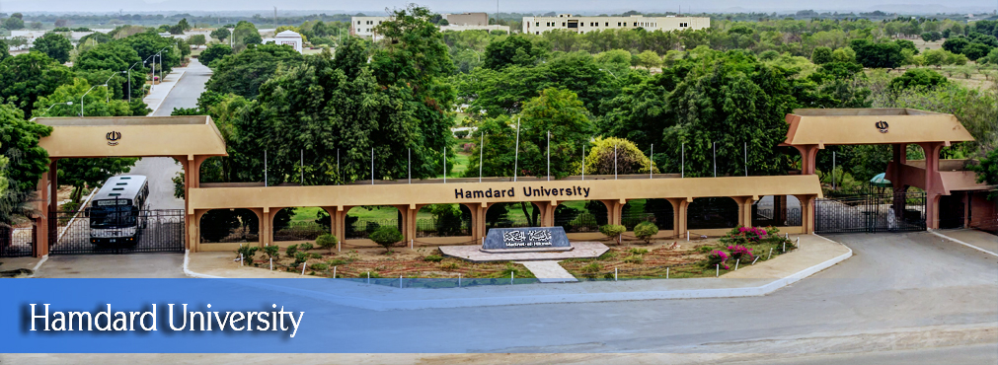
Web-Based Phishing Detection System
FYP Proposal
Muhammad Ibtehaj Mubarak | (2278-2022)
Muhammad Zaid Bin Saud | (1768-2022)
Muhammad Azaan Rashid | (2996-2020)
Supervisor Engr. Abdul Razaque External Supervisor None
Hamdard University

Slide 2

Outline
Group Introduction
Problem Statement
Project Objectives
Project Scope
Comprehensive Literature Review
Architectural Big Picture
Methodology
Role & Responsibility
Project Milestones
Project Plan (Time lines)
Project Budgeting
Project Tools
Project Deliverables

Slide 3
Group Introduction
Group Members
Muhammad Ibtehaj Mubarak
Muhammad Zaid Bin Saud
Muhammad Azaan Rashid
Supervisor: Mr. Abdul Razaque
Why we selected him as supervisor?
He has guided several industry-related web application projects in the past. Our project scope and domain is closely aligned with his expertise, making him the ideal mentor. We are confident that he will provide valuable guidance throughout the development.
Relevant Expertise
He has relevant experience in mobile app development and security-based projects, which directly supports our project goals.
Relevant Experience
He has 6 years of industrial experience in the IT sector, working on real-world applications and secure systems.

Slide 4
Problem Statement
“Web-Based Phishing Detection System”
Internet users are increasingly vulnerable to phishing attacks that trick them into clicking fake or malicious links. These links can result in data theft, financial loss, or unauthorized system access.
Most users are unaware of such threats and lack a simple method to verify link safety.
There is a strong need for a lightweight, browser-accessible web application that can detect, block, and warn users about phishing links in real time, while also assisting them through a built-in chat-based support system.
Additionally, many existing solutions are either too complex or require installation, which makes them unsuitable for non-technical or casual users.

Slide 5
Project Objectives
To Develop a Phishing Link Detection System Build a rule-based web system that can identify suspicious or phishing URLs based on pre-defined patterns and blacklist APIs.
To Block Detected Malicious Links Prevent users from accidentally accessing harmful links by blocking them and showing browser-based warning messages.
To Provide Real-Time Alerts Notify users instantly when a phishing link is detected through on-screen alerts in the web interface.
To Integrate a Chatbox for User Support Include a built-in chat feature that assists users by explaining scan results and guiding them on how to stay safe.
To Ensure a User-Friendly Interface Design a clean, responsive, and intuitive web interface that makes link scanning and warnings clear and accessible to all users.

Slide 6
Project Scope
The scope of this project is to design and develop a web-based phishing detection system that scans, analyzes, and blocks malicious or suspicious URLs in real-time.
The system will be built using rule-based logic, integrated with blacklist APIs like PhishTank or Google Safe Browsing, and powered by a trained Machine Learning model (Random Forest Classifier) for smarter detection.
Core Features: 1. Detect and block phishing links instantly 2. Display alerts and warnings via the web interface 3. Provide basic support through a built-in chatbot 4. Simple and responsive user interface 5. Python Flask backend with API and ML integration
Scalable & Expandable: 1. Ready for AI chatbot upgrades 2. Can be extended to browser extensions or desktop apps 3. Suitable for use in cybersecurity education and corporate environments
The final system will serve both technical and non-technical users, offering a reliable tool for phishing detection across web environments. The architecture is scalable, allowing future integration with browser extensions, mobile versions, or enterprise-level security suites.

Slide 7
Comprehensive Literature Review
Rule-Based Detection Approaches Basnet et al. (2015) developed a rule-based phishing detection method by analyzing attacker behaviours. Their system achieved 95–99% accuracy with low false positives (0.5–1.5%), supporting the strength of well-designed rule-based systems like ours.
Heuristic and Blacklist Hybrid Schemes Temple University researchers introduced MobiFish, which combined heuristic detection with blacklist checks. Though limited in detecting zero-day attacks, it proved highly effective for known phishing patterns, a lightweight strategy our system builds on.
Rule-Based Web Detection Systems Gale-sourced research demonstrated that web-based phishing apps using lightweight rule sets can detect malicious URLs efficiently in real-time. These approaches are ideal for browser-based tools like ours due to their speed and simplicity.
Comprehensive Survey of Detection Techniques Dholakia & Agrawal (2018) concluded that no single solution is universally effective. Rule-based and blacklist systems work well for known threats, but handling complex or zero-day phishing requires machine learning, supporting our inclusion of an ML model.
Rule-Based SMS-Based Detection (Analogous) Akande et al. (2021) created a smishing detection app using rule-based classifiers (RIPPER, C4.5). While SMS-specific, the detection logic applies to phishing links on the web, especially in systems where low resource use is important.

Slide 8
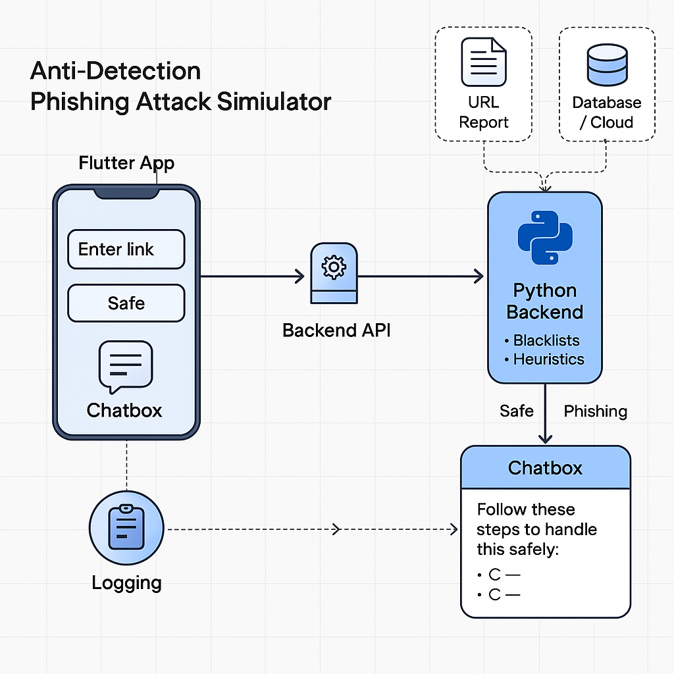




Architecture Big Picture
Website Interface Of Web-Based Phishing Detection System
Enter Link:
The Link Is Safe!
User → Web-App → Backend API → Detection Engine → Result → Chatbox + Logs

Slide 9
Project Methodology
Web-App Development Model: Waterfall Model:
We are following the Waterfall Model, which is a linear and sequential software development approach.
Each phase is completed before moving to the next, ensuring structured development with well-defined deliverables.
Phases of Waterfall in Our Project:
System Design: Planned web UI, backend flow, and URL analysis pipeline
Implementation: Developed frontend using HTML/CSS/JavaScript and backend using Python (Flask)
Testing: Verified phishing detection accuracy and overall web functionality
Deployment: Hosted the web app on a local or cloud server for browser access
Maintenance: Handled bug fixes and planned feature upgrades (like AI chatbot)
WHY?
Simple and easy to understand
Clearly defined stages and outputs
Suitable for small, focused projects with stable requirements
Easy to document and present in university FYP evaluations

Slide 10
Project Role & Responsibilities
RACI Chart
R = Responsible, A = Accountable, C = Consulted, I = Informed
Modules | Supervisor | Ibtehaj | Zaid | Azaan
Proposal & Project Planning | C, I | A, R | R | A
Literature Review | C, I | R | A | A, R
UI Design (Web Frontend) | C | A | R | R
Rule-Based Detection Logic | C, I | R | A, R | A
Blacklist & Heuristic Integration | I | A, R | A | R
Python API - Frontend Comm. | C, I | A, R | R | A
Web App Testing & Debugging | C, I | A | A, R | R
Final Report & Presentation | C, I | A, R | R | A
Communication & Documents | C, I | A | R | R

Slide 11
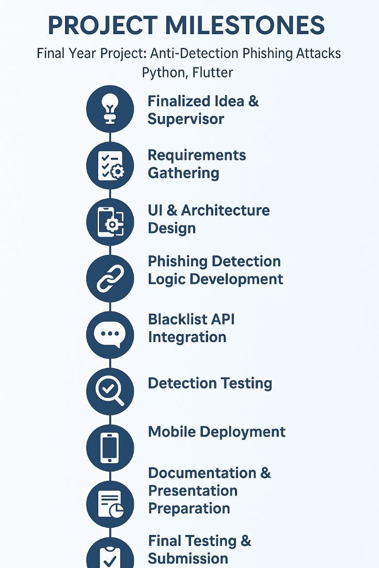

Project Milestones
Finalized project idea and selected supervisor
Gathered system and security-related requirements
Designed web architecture and UI layout
Create rule-based web phishing detection logic
Integrated blacklist API and heuristic rules
Development of chatbox support system
Test detection accuracy with sample links
Deployment of web-based system
Prepared documentation and presentation slides
Final testing, bug fixing, and submission
Web

Slide 12
Project Plan
Task ID | Task Name | Start Date | End Date | Duration
T1 | Proposal & Project Planning | Aug 1, 2025 | Aug 14, 2025 | 2 weeks
T2 | Literature Review | Aug 18, 2025 | Aug 25, 2025 | 1 week
T3 | UI Design (Web Frontend) | Sep 1, 2025 | Sep 30, 2025 | 1 month
T4 | Rule-Based Detection Logic | Oct 5, 2025 | Dec 5, 2025 | 3 month
T5 | Blacklist & Heuristic Integration | Dec 15, 2025 | Feb 20, 2026 | 2 month
T6 | Python API - Frontend Comm. | Mar 01, 2026 | Apr 01, 2026 | 1 month
T7 | Web App Testing & Debugging | May 5, 2026 | Mar 12, 2026 | 1 week
T8 | Final Report & Presentation | May 15, 2026 | June 01, 2026 | 15 days
T9 | Communication & Documents | June 05, 2026 | June 25, 2026 | 10 days

Slide 13
Project Budgeting
Category | Item Description | Cost (PKR)
1. Equipment - Laptops (3 units) 1. Internet - Monthly Internet / Data | PKR 230,000 (high-end laptops) PKR 1300/month x 12 months x 3 students | PKR 230,000 PKR 46,800
2. Transport - Monthly Transport | PKR 1500 x 12 months x 3 students | PKR 54,000
3. Miscellaneous Funds | Repairs, software, printing, etc.. | PKR 30,000
- Stationery & Supplies | Notebooks, pens, etc.. | PKR 10,000
TOTAL |  | PKR 3,70,800

Slide 14
Project Tools
Software Requirements
Hardware Requirements
Visual Code
Python Flask/FastAPI frameworks
Tensor Flow
MySQL
GitHub
Laptop (Multi-Core, i9, 16GB, 500GB SSD)
Backup Hard drives
Internet dongle
Printer

Slide 15
8- Project Deliverables
FYP-I Evaluation
FYP-II Evaluation
SRS Document
Budget Document
Work Breakdown Structure
Project Plan
Design Mockup
Data Collection Interface
Project Report - I
Funding Proposal
Proposed System
UI Design
User Manual
Source Code CD
Project Report - II

Slide 16
THANK YOU!

